Slide 1
Domain Ontology for Grounded Theory
@aleadorjan

Slide 2


Slide 3
Research Question
RQ: How to model qualitative research Grounded Theory methodology ? An Ontology approach
Adorjan, A., Vargas-Solar, G., & Motz, R. (2022, December). Towards a human-in-the-loop curation: A qualitative perspective. In 2022 IEEE/ACS 19th international conference on computer systems and applications (AICCSA) (pp. 1-8). IEEE.

Slide 4
Methods
Interview with Domain Experts
Participant Observation in the Field
Modelling and Prototyping
Adorjan, A. (2023, August). Towards a Researcher-in-the-loop Driven Curation Approach for Quantitative and Qualitative Research Methods. In European Conference on Advances in Databases and Information Systems (pp. 647-655). Cham: Springer Nature Switzerland.
Adorjan, A., Vargas-Solar, G., & Motz, R. (2022, December). Towards a human-in-the-loop curation: A qualitative perspective. In 2022 IEEE/ACS 19th international conference on computer systems and applications (AICCSA) (pp. 1-8). IEEE.

Slide 5
Use Case
Prácticas de estudio y de lectura de estudiantes de la Licenciatura en Comunicación de la Facultad de Información y Comunicación, Uruguay
Adorjan, A. (2023, August). Towards a Researcher-in-the-loop Driven Curation Approach for Quantitative and Qualitative Research Methods. In European Conference on Advances in Databases and Information Systems (pp. 647-655). Cham: Springer Nature Switzerland.
Adorjan, A., Vargas-Solar, G., & Motz, R. (2022, December). Towards a human-in-the-loop curation: A qualitative perspective. In 2022 IEEE/ACS 19th international conference on computer systems and applications (AICCSA) (pp. 1-8). IEEE.

Slide 6

Qualitative Research: Grounded Theory
Generated Artefacts
Ontologies Development
"
"
Protégé: A free, open-source ontology editor and framework.

Slide 7
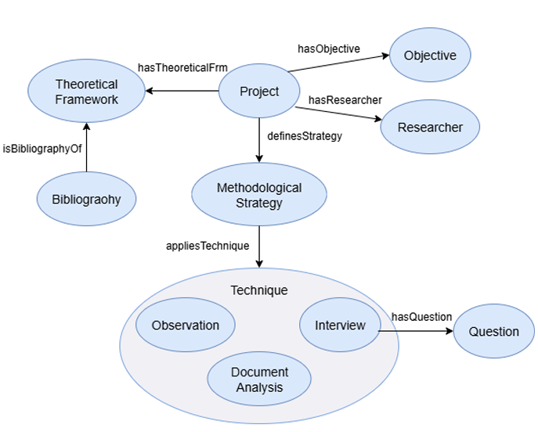
Model
Project Formulation
Rohrer, E., Motz, R., Sandín, J. P., Méndez, E., Fleitas, F., & Pérez, A. (2025, September 10–12). Domain ontology for grounded theory qualitative research: Bridging interpretation and structure in digital humanities [Paper presentation]. FOIS 2025 Satellite events co-located with the 15th International Conference on Formal Ontology in Information Systems, Catania, Italy

Slide 8
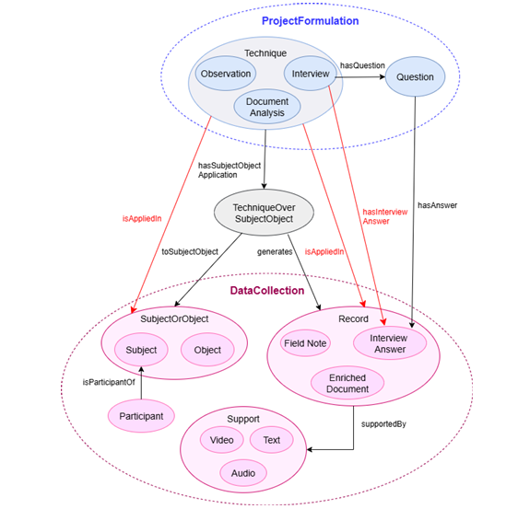
Model
Data Collection
Rohrer, E., Motz, R., Sandín, J. P., Méndez, E., Fleitas, F., & Pérez, A. (2025, September 10–12). Domain ontology for grounded theory qualitative research: Bridging interpretation and structure in digital humanities [Paper presentation]. FOIS 2025 Satellite events co-located with the 15th International Conference on Formal Ontology in Information Systems, Catania, Italy

Slide 9
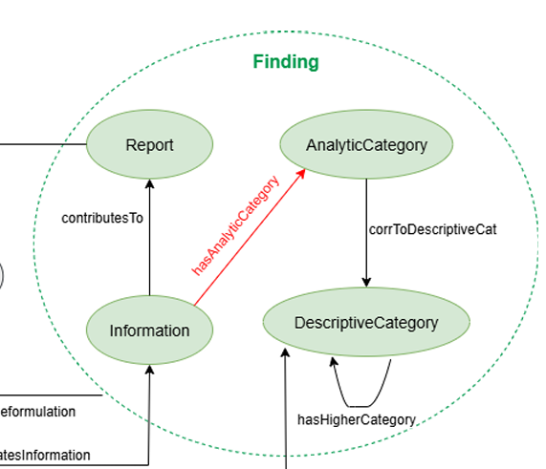
Model
Findings
Rohrer, E., Motz, R., Sandín, J. P., Méndez, E., Fleitas, F., & Pérez, A. (2025, September 10–12). Domain ontology for grounded theory qualitative research: Bridging interpretation and structure in digital humanities [Paper presentation]. FOIS 2025 Satellite events co-located with the 15th International Conference on Formal Ontology in Information Systems, Catania, Italy

Slide 10
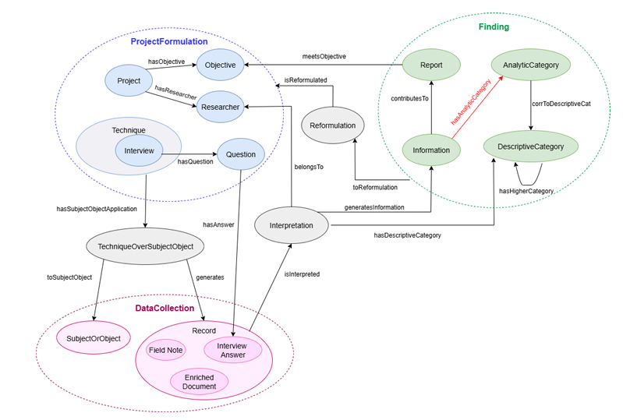
Model
Final Model
Rohrer, E., Motz, R., Sandín, J. P., Méndez, E., Fleitas, F., & Pérez, A. (2025, September 10–12). Domain ontology for grounded theory qualitative research: Bridging interpretation and structure in digital humanities [Paper presentation]. FOIS 2025 Satellite events co-located with the 15th International Conference on Formal Ontology in Information Systems, Catania, Italy

Slide 11

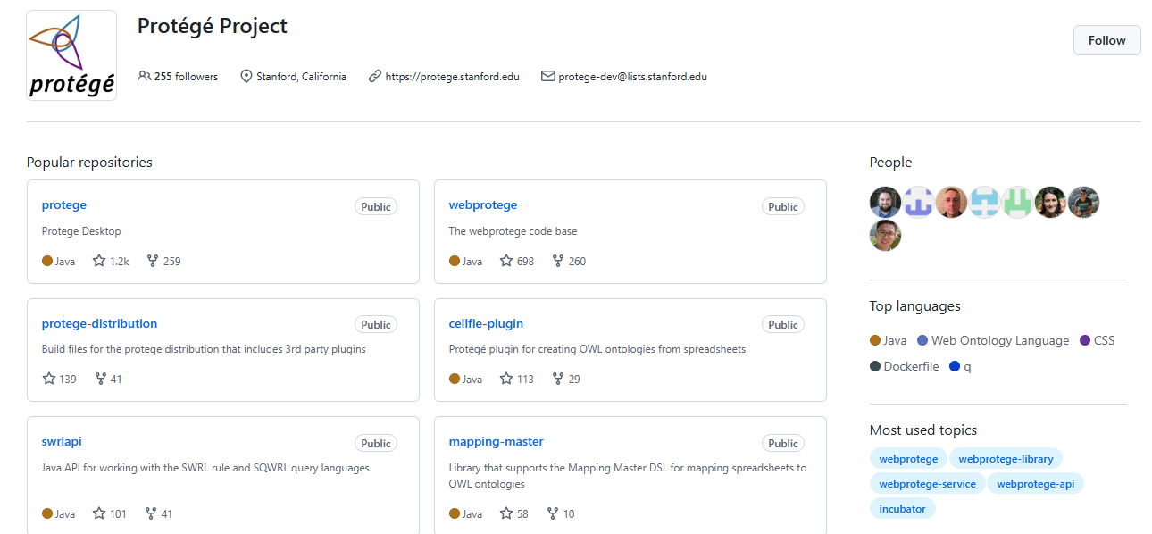
Open Source tool
"
"
Qualitative Research Ontology - Summary | TechnoPortal
Deploy:

Slide 12
Qualitative Research: Grounded Theory
Actual Tools for
Ontologies Development
"
"
Qualitative Research Ontology - Summary | TechnoPortal
Deploy:

Slide 13
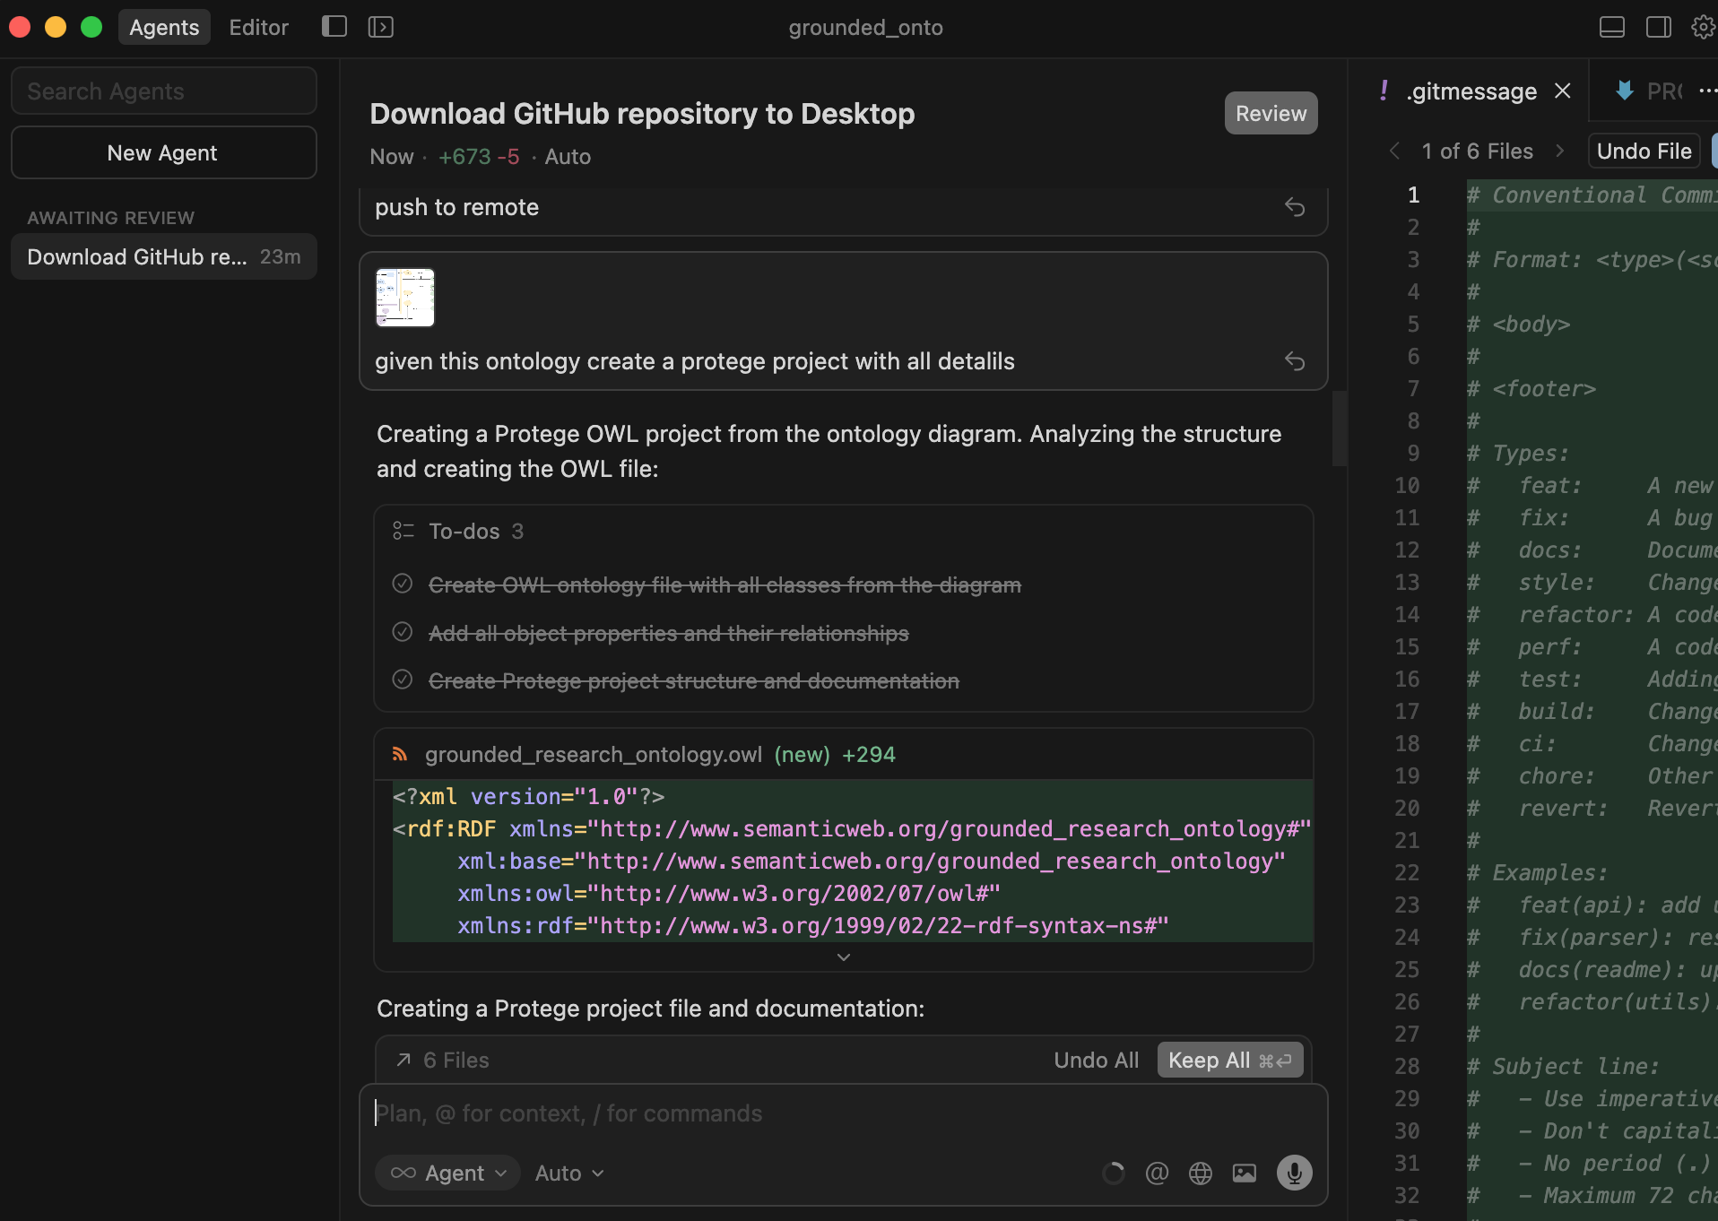

AI Tools to Generate Ontologies
"
"
https://cursor.com/
https://cursor.com/docs/agent/overview

Slide 14
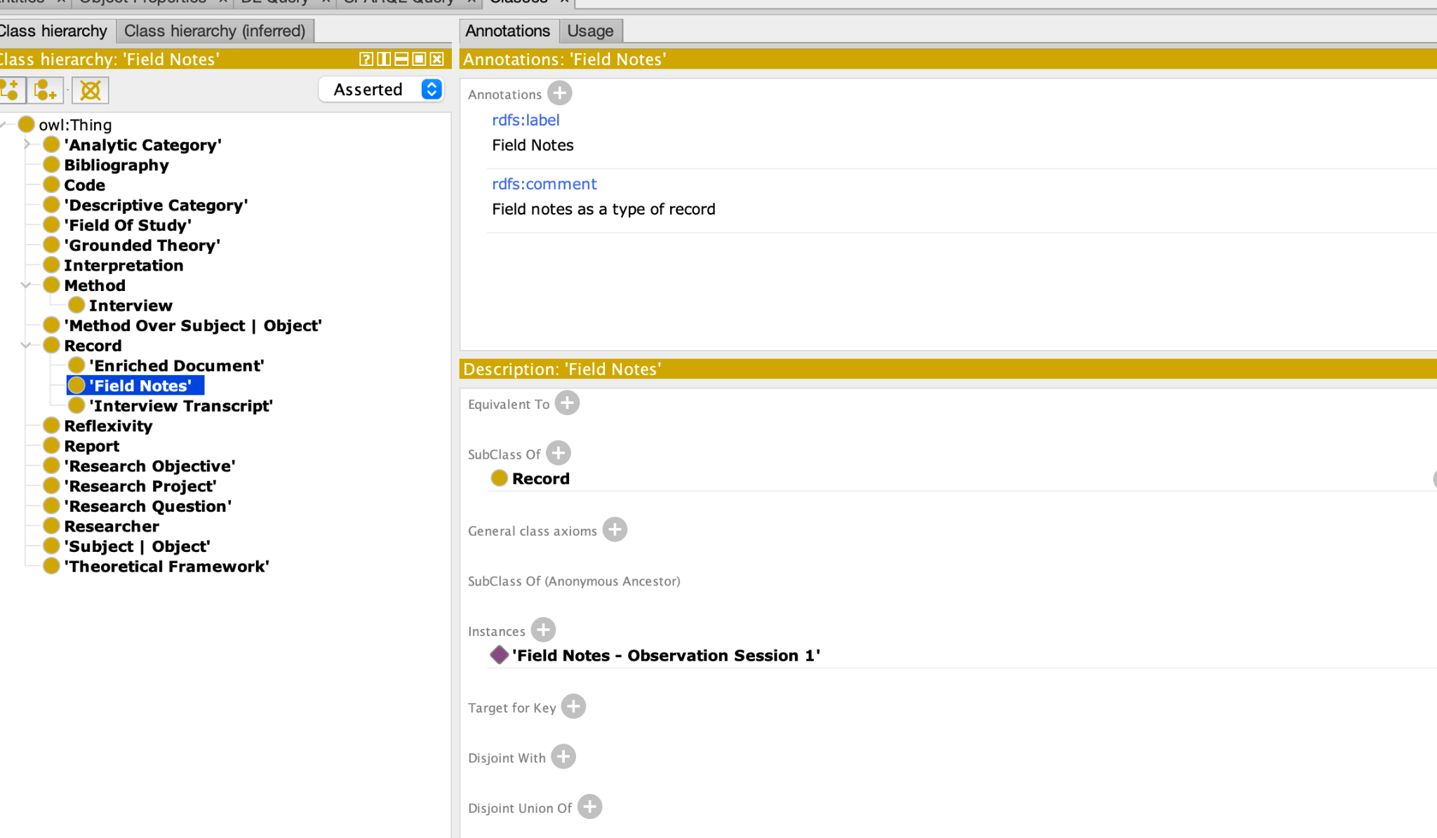
Protegé
Protegé
Protegé is an open-source platform for creating, editing, and managing Web Ontology Language
"
"
https://protege.stanford.edu/
Qualitative Research Ontology - Summary | TechnoPortal

Slide 15
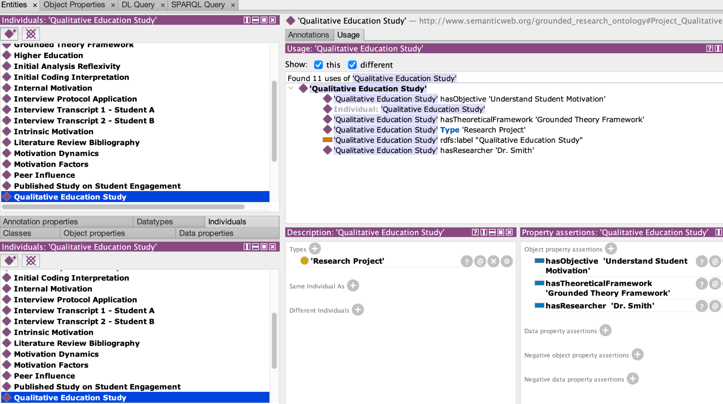
Protegé
Instances
"
"
https://protege.stanford.edu/

Slide 16
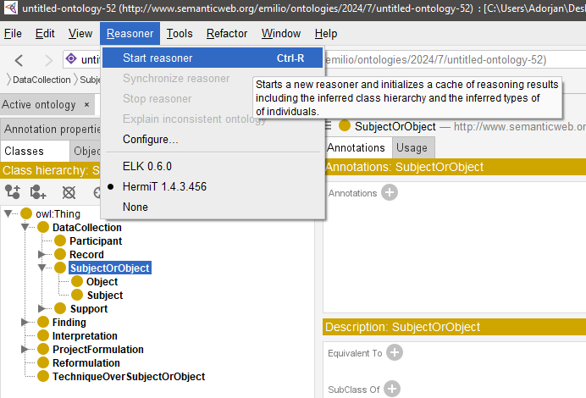
Reasoner | Hermit
Protegé
HermiT is a reasoner for ontologies written using the Web Ontology Language (OWL)

Slide 17
Reasoner | Hermit
Protegé

Slide 18
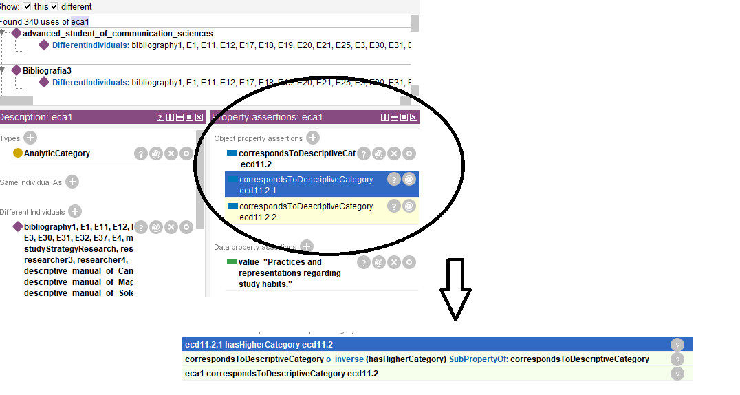
Reasoner | Inference
Protegé

Slide 19
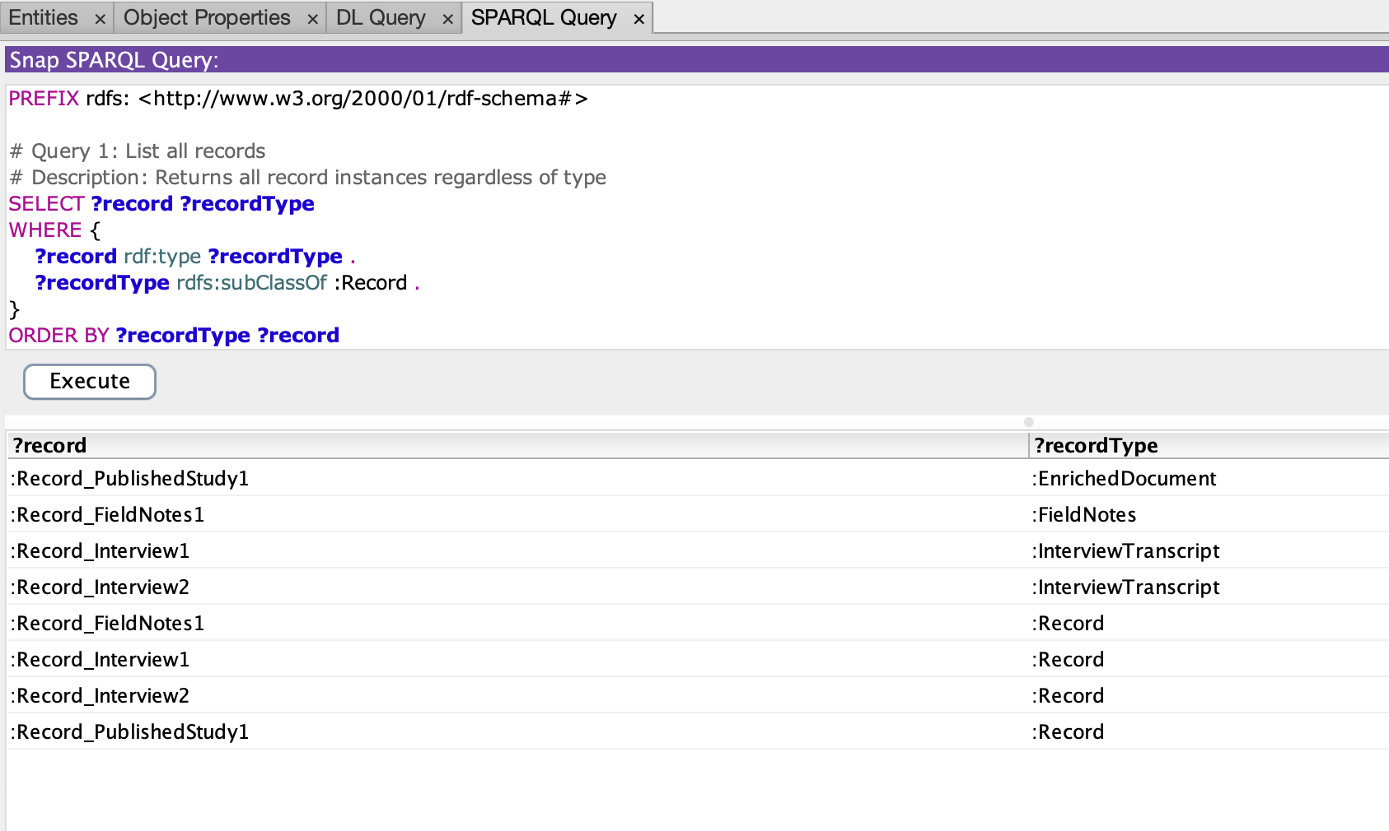
Protegé
SparQL
"
"
https://protege.stanford.edu/

Slide 20
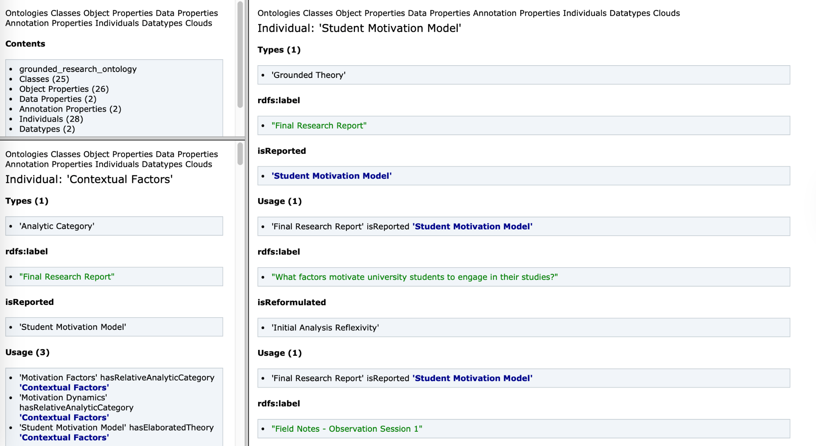
Protegé
Doc Navigation
"
"
https://protege.stanford.edu/

Slide 21
A Final Thought
..is not about technology is about methodology
"
"

Slide 22

Thanks !!
@aleadorjan

